Slide 1


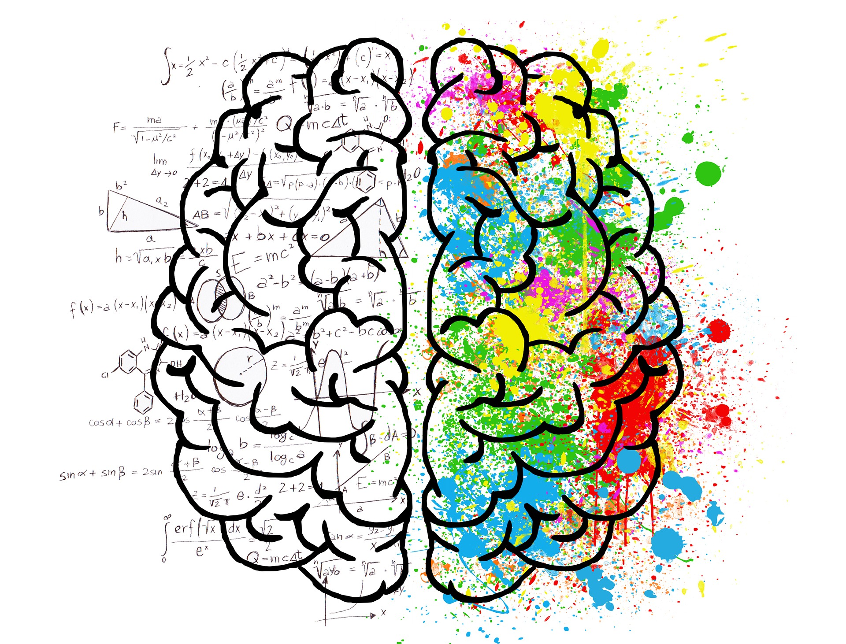
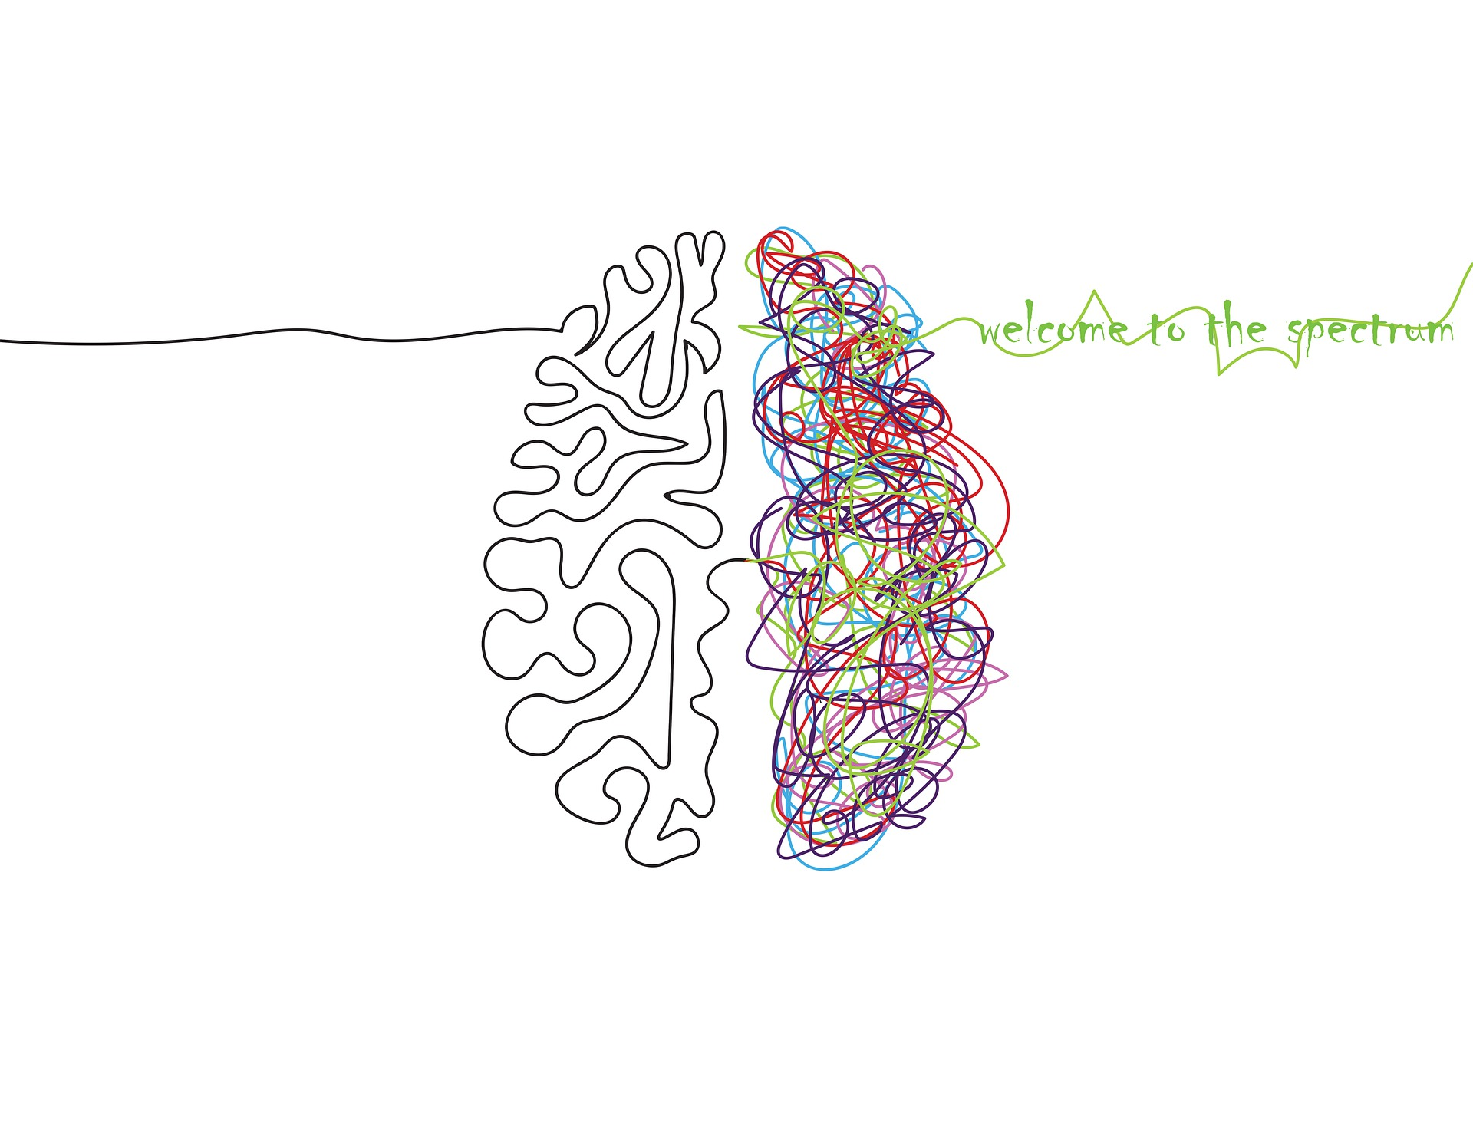
THE MIND IS A MYSTERY
UNLOCKING THE SECRETS OF THE BRAIN
Rachelle Chandler Fertig
&
Samantha Wanek
Notes:
Rachelle: The Mind Is A Mystery, unlocking the secrets of the brain…

Slide 2
A META-ANALYSIS
Rachelle Chandler Fertig
Samantha Wanek
Experience in data analysis, using Excel, Python, R, and SQL
Dual Background:
Project management, operations, logistics, marketing, communication, business metrics, sales and performance analytics for service and retail sales industries.
Craniosacral Therapist specializing in the brain, central nervous system, immune, and endocrine systems with a focus on nutritionally balanced brain/body relationships.
Proficient with in-office and remote collaboration tools such as Slack, Teams, Microsoft 365, VPN, Trello, Zoom as well as industry-specific proprietary software systems.
Skilled in data and conceptual visualizations/presentations with the ability to translate intricate details into actionable takeaways.
Detailed, thorough and methodical work style while working either independently or in team collaboration settings.
Experience in data analysis, using Python, R, and SQL.
Skilled in data visualization/presentation with the ability to concisely communicate complex data insights to non-technical parties.
Strong understandings of data ethics and privacy considerations, ensuring ethical use of data.
Ability to effectively collaborate with team members, including providing and actively seeking feedback from others.
Familiarity with remote collaboration tools, such as Slack, Zoom, and Trello, and the ability to adapt quickly to new tools and technologies.
Strong time management skills to prioritize tasks, manage competing deadlines, and adapt to changing priorities.
OUR BACKGROUNDS
Notes:
Rachelle:
A meta-analysis by Rachelle Chandler Fertig and Samantha Wanek.
Hi! My name is Rachelle Chandler Fertig.
I have experience in data analysis using Excel, Python, R, and SQL. My professional background includes project management, operations, logistics, marketing, communication, business metrics, sales, and performance analytics for service and retail industries.
As a 20-year craniosacral therapist specializing in the brain, central nervous system, immune, and endocrine systems with a focus on nutritionally balanced brain/body relationships, I bring a unique perspective to this project.
I'm proficient with collaboration tools like Slack, Teams, Microsoft 365, VPN, Trello, Zoom, as well as industry-specific proprietary software systems. I'm also skilled in creating data and conceptual visualizations/presentations, translating intricate details into actionable takeaways.
My work style is detailed, thorough, and methodical, and I can work independently or in team collaboration settings.
Samantha: Hi I’m Samantha Wanek.
Although I don’t have working background in Data Science or relation to the topic of this project,
I have completed my certification training from SCI, WOZ-U, & Entity Academy.
Along the way, I have gained extensive experience in data analysis using Python, R, and SQL.
Presenting complex data insights to non-technical stakeholders.
I also have a deep understanding of data ethics and privacy considerations,
And I pride myself on being an effective team collaborator
I have experience using remote collaboration tools like Slack, Zoom, and Trello, and I am quick to adapt to new tools and technologies.
My time management skills allow me to prioritize tasks, manage deadlines, and adapt to changing priorities.

Slide 3
OUR DATA AND ITS IMPORTANCE
DATA SUMMARY: 105 study participants (47 pairs) were tested across 39 essential elements.
Our dataset includes urine test results for 20 toxic and 19 essential elements.
The study focuses on young children with Autism Spectrum Disorder and their mothers, compared to typically developing children and their mothers.
Most studies use blood tests, but urine measurements offer a different perspective. Urine measurements indicate the amount of a component that is leaving the body.
Our dataset is important because it provides unique insights into the relationship between toxic and essential elements and Autism Spectrum Disorder.
Notes:
Rachelle: The body and the brain have a co-dependent relationship. The brain is dependent on the body for nutritional and sensory input necessary for growth and regulation. The body is dependent on the brain to send out the neurotransmitters that signal movement, regulation, digestion, sleep, cognitive integration, and emotional processing. This co-dependent relationship is better known as neurobiological human development.
Our data aims to provide insight to elements leaving the body that may affect the neurobiological human developmental connection to the brain.
Blood test studies are subject to the influence of homeostasis, or our body’s natural ability to adjust and compensate internally to balance micronutrients. Urine measurements offer a different perspective, as they indicate the amount of a component that is leaving the body.
In summary, our data contains 105 study participants made up of 47 pairs of children and mothers that were tested across 39 elements where half are toxic and the other half essential.
Our dataset is important because it provides unique insights into the relationship between toxic and essential elements and Autism Spectrum Disorder.

Slide 4
A META-ANALYSIS OF A URINALYSIS
INITIAL ASSESEMENT OF THE DATASET IN R
Status | Type | Elements (39)
ASD | Child | <data>
TD | Child | <data>
ASD | Mother | <data>
TD | Mother | <data>
Initial Analysis Objective:
Group by + Summarize functions to create comparison groups
Evaluate which elements have the greatest influence with ASD and TD groups
Key Observations: The data alpha-organized the elements into two groups to differentiate between Toxic and Essential elements
Notes:
Samantha:
Engineering the approach to our analyses was the most challenging part of the project.
The question that stood out the most to us after clearly observing the data was “What elements are going to be high in children with ASD, that likely won't be high in the typically developing children?”
In order to perform a deep-dive comparison between two dependent variables, with two levels each, we carefully divided the DV “Type” into children and mothers.
Then we created 4 subset versions from there making the subgroups “child toxic”, “child essential”, “mother toxic”, & “mother essential.”

Slide 5
A META-ANALYSIS OF A URINALYSIS
ANALYTICAL OBJECTIVES:
Objective One: Is there a predictive relationship between levels of toxic and essential elements and the occurrence of ASD in children?
Question A – How well does the data predict ASD or TD in children?
Question B - Which elements are the greatest predictors of ASD or TD in children?
Objective Two: From the modeled elements, how does the urine test differ (Toxic vs Essential) for children with ASD to TD children?
Conclusions – Predictive Elements - Children
Objective Three: Is there a predictive relationship between levels of toxic and essential elements and the occurrence of ASD in mothers?
Question C – How well does the data predict ASD or TD in mothers?
Question D - Which elements are the greatest predictors of ASD or TD in mothers?
Objective Four: From the modeled elements, how does the urine test differ (Toxic vs Essential) for mothers with ASD to TD mothers?
Conclusions – Predictive Elements - Mothers
Objective Five: From the modeled elements, how does the urine test differ (Toxic vs Essential) for children with ASD to their ASD mothers?
Objective Six: From the modeled elements, how does the urine test differ (Toxic vs Essential) for TD children to their TD mothers?
Meta-Analysis Conclusions
Notes:
Rachelle: As you might expect in data science, that initial question led to many more. And those next questions led to even more questions. Our data felt like pandoras box.
We quickly unraveled the need to perform a meta-analysis on our urinalysis data. As our project unfolded, the objectives we set to find became:
Is there a predictive relationship between levels of toxic and essential elements and the occurrence of ASD in children?
How well does the data predict ASD or TD in children?
Which elements are the greatest predictors of ASD or TD in children?
How does the urine test differ (Toxic vs Essential) for children with ASD to TD children?
Is there a predictive relationship between levels of toxic and essential elements and the occurrence of ASD in mothers?
How well does the data predict ASD or TD in mothers?
Which elements are the greatest predictors of ASD or TD in mothers?
How does the urine test differ (Toxic vs Essential) for mothers with ASD to TD mothers?
How does the urine test differ (Toxic vs Essential) for children with ASD to their ASD mothers?
How does the urine test differ (Toxic vs Essential) for TD children to their TD mothers?

Slide 6
A META-ANALYSIS OF A URINALYSIS
ANALYSIS APPROACH:
Questions & Objectives Setup:
Clean, Standardize, Subset and Subgroup the data
In Subgroup:
Create a binary logistics regression model to evaluate the effectiveness of the data to predict the ASD / TD status
Run a binary stepwise-regression to evaluate which elements have the greatest influence over predicting ASD or TD
Assess multicollinearity by Variance Influence Factor
Run descriptive statistics for modeled elements
 | SUBSET | SUBGROUP 1 | SUBGROUP 2
1 | Child | childToxic ASD | childToxic TD
2 |  | childEssential ASD | childEssential TD
3 | Mother | motherToxic ASD | motherToxic TD
4 |  | motherEssential ASD | motherEssential TD
5 | ID Number | childToxic ASD (paired) | motherToxic ASD
6 |  | childToxic TD (paired) | motherToxic TD
Compare subgroups to extrapolate meta-analysis
Identify highest-influence elements per subgroup
Define highest-influence elements for ASD / TD
Review elements for developmental influence
Understand the impact of these elements on ASD
Notes:
Samantha:
We cleaned our data, because the names were not formatted in a recognizable way for our analysis notebook.
When we got past that, we standardized our data to help avoid the numerical instabilities that can occur when working with data that has vastly different scales of measurement.
We separated our data into the appropriate groupings and set to run our tests.

Slide 7
IS THERE A PREDICTIVE RELATIONSHIP BETWEEN LEVELS OF TOXIC AND ESSENTIAL ELEMENTS AND THE OCCURRENCE OF ASD IN CHILDREN?
OBJECTIVE ONE
QUESTION A: How well does the data predict ASD or TD in children?
 | SUBSET | SUBGROUPS | SIGNIFICANT ELEMENTS | BORDERLINE SIGNIFICANT | ACCURACY
1 | Child | childToxic ASD + childToxic TD | Tungsten |  | 85%
2 |  | childEssential ASD + childEssential TD | Sulfur, Magnesium |  | 87%
QUESTION B: Which elements are the greatest predictors of ASD or TD in children?
 | SUBSET | SUBGROUPS | SIGNIFICANT ELEMENTS | BORDERLINE | ACCURACY | OVERALL MODEL
1 | Child | childToxic ASD | Gadolinium | Mercury | 27% | Significant
2 |  | childToxic TD | Tin | Tungsten
3 |  | childEssential ASD | Potassium | Boron | 45% | Significant
4 |  | childEssential TD | Sulfur | Calcium, Magnesium, Zinc
CONCLUSIONS – PREDICTIVE RELATIONSHIPS
Notes:
Rachelle:
Our first objective was to determine if there was a predictive relationship between levels of toxic and essential elements and the occurrence of ASD in children.
To structure our analysis with a balanced and complete framework, we realized we could approach our data from two opposite perspectives and evaluate trends that emerged consistent with both predictive models.
To answer Question A, “How well does the data predict ASD or TD in children?”, a binary logistics regression was performed.
The data proved 85-87% accurate meaning there were 13-15% of the participants whose urinalysis matched their counterpart group and not their own.
For the childToxic group as a whole: (ASD and TD combined) Tungsten was the only significant element
For the childEssential group as a whole: Sulfur and Magnesium were the only significant elements
To answer Question B, “Which elements are the greatest predictors of ASD or TD in children?”, a binary stepwise logistics regression was performed.
While the models produced included the significant elements from the Question A’s logistics regression, each model was less accurate and included a larger scope of toxic and essential elements.
The elements that are the greatest predictors of ASD or TD in children per the Stepwise Regression Modeling were:
childToxic ASD = Gadolinium (borderline Mercury)
childToxic TD = Tin (borderline Tungsten)
Child Essential ASD = Potassium (borderline Boron)
Child Essential TD = Sulfur (borderline Calcium, Magnesium, Zinc)
Surprisingly, the childToxic model had the second lowest accuracy with 27% however the model was statically significant
The childEssential model had the highest accuracy with 45% and was statistically significant

Slide 8
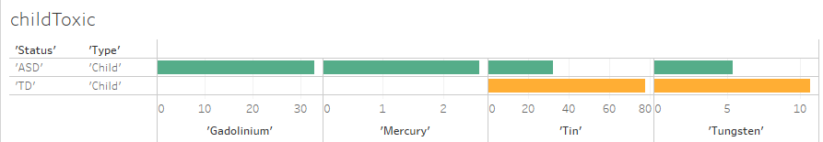

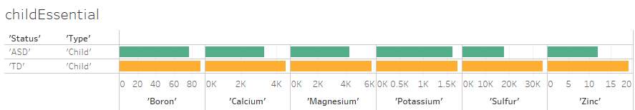
FROM THE MODELED ELEMENTS, HOW DOES THE URINE TEST DIFFER (TOXIC VS. ESSENTIAL) FOR CHILDREN WITH AUTISM (ASD) COMPARED TO TYPICALLY DEVELOPING (TD) CHILDREN?
OBJECTIVE TWO
CONCLUSIONS – PREDICTIVE ELEMENTS
Descriptive Statistics for Subgroup: Means Comparison
childToxic
Status | Gadolinium | Mercury | Tin | Tungsten
ASD | 1.57 | 0.1240 | 1.53 | .0257
TD | 0.00005 | 0.0002 | 3.00 | 0.411
childEssential
Status | Boron | Calcium | Magnesium | Potassium | Sulfur | Zinc
ASD | 3.64 | 157.09 | 202.33 | 77.62 | 848.57 | 0.057
TD | 3.44 | 174.19 | 225.50 | 66.73 | 1322.69 | 0.744
Sum Comparison
CONCLUSIONS:
MEANS Identifies which elements are predictive for either ASD or TD.
SUM ASD children do in fact have higher toxicity and lower essential elements, except for Tin and Tungsten.
Notes:
Samantha:
Objective two aimed to evaluate the differences in the UA’s between ASD children and TD children,
And to do this we looked at the descriptive statistics to show us a comparison of the average amounts for the isolated elements in objective one.
The differences are relatively noticeable when compared between ASD and TD children:
Gadolinium and Mercury are much lower in TD children.
Tin and Tungsten are notably higher in TD children than ASD children.
The average amounts of the isolated essential elements were much closer in range,
But Boron & Potassium had slightly higher levels in ASD children than TD children.
Sulfur nearly doubles in TD children from the ASD children,
And Zinc appears to be approximately 13 times higher in TD children.
We moved into graphing a comparison of the sums for these elements to visualize the data we were seeing.
What’s interesting to see is that higher levels of Tin and Tungsten were found in TD children, and not ASD children.
And ASD children are lower in all essential elements in the model.

Slide 9
IS THERE A PREDICTIVE RELATIONSHIP BETWEEN LEVELS OF (TOXIC VS. ESSENTIAL) ELEMENTS AND THE OCCURRENCE OF (ASD) IN MOTHERS?
OBJECTIVE THREE
QUESTION A: How well does the data predict ASD or TD in mothers?
 | SUBSET | SUBGROUPS | SIGNIFICANT ELEMENTS | BORDERLINE SIGNIFICANT | ACCURACY
1 | Mother | motherToxic ASD + motherToxic TD | Lead, Tungsten | Barium, Uranium | 78%
2 |  | motherEssential ASD + motherEssential TD | Molybdenum |  | 74%
QUESTION B: Which elements are the greatest predictors of ASD or TD in mothers?
 | SUBSET | SUBGROUPS | SIGNIFICANT ELEMENTS | BORDERLINE | ACCURACY | OVERALL MODEL
1 | Mother | motherToxic ASD | Cadmium | Uranium | 35% | Significant
2 |  | motherToxic TD | Gadolinium, Lead, Thallium | Barium, Beryllium
3 |  | motherEssential ASD | Molybdenum, Phosphorus |  | 12% | Not-Significant
4 |  | motherEssential TD | Iron |  | 75%
CONCLUSIONS – PREDICTIVE RELATIONSHIPS
Notes:
Rachelle:
Our third objective was to determine if there was a predictive relationship between levels of toxic and essential elements and the occurrence of ASD in mothers.
Again, we deployed our dual-angle regression approach to build the analysis framework.
To answer Question A, “How well does the data predict ASD or TD in mothers?”, a logistics regression was performed. The data proved 74-78% accurate meaning there were 22-26% of the participants whose urinalysis matched their counterpart group and not their own.
For the motherToxic group as a whole: (ASD and TD combined) Lead and Tungsten were significant elements (Barium and Uranium were borderline significant)
For the motherEssential group as a whole: Molybdenum was the only significant element
To answer Question B, “Which elements are the greatest predictors of ASD or TD in mothers?”, a stepwise logistics regression was performed.
While the models produced included the significant elements from the logistics regression, again, each model was less accurate and included a larger scope of toxic and essential elements.
The elements that are the greatest predictors of ASD or TD in mothers were:
motherToxic ASD = Cadmium (borderline Uranium)
motherToxic TD = Gadolinium, Lead, Thallium (borderline Barium, Beryllium)
motherEssential ASD = Molybdenum, Phosphorus
motherEssential TD = Iron
Surprisingly, the motherToxic model had the second highest accuracy with 35% and was statically significant
Contrastly, the motherEssential model had the lowest accuracy with a mere 12% and became our only model that was not statically significant

Slide 10
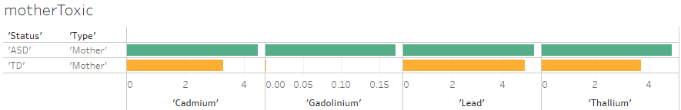
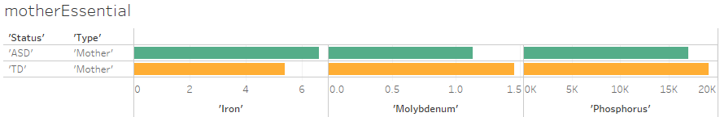
FROM THE MODELED ELEMENTS, HOW DOES THE URINE TEST DIFFER (TOXIC VS. ESSENTIAL) FOR MOTHERS WITH AUTISM (ASD) TO TYPICALLY DEVELOPING (TD) MOTHERS?
OBJECTIVE FOUR
CONCLUSIONS – PREDICTIVE ELEMENTS
Descriptive Statistics for Subgroup: Means Comparison
motherToxic
Status | Cadmium | Gadolinium | Lead | Thallium
ASD | 0.56 | -0.096 | -0.476 | -0.240
TD | 0.23 | -0.098 | -0.508 | -0.536
motherEssential
Status | Iron | Molybdenum | Phosphorus
ASD | -0.152 | -0.634 | -0.592
TD | -0.780 | -0.429 | -0.443
Sum Comparison
CONCLUSIONS:
MEANS Identifies which elements are predictive for either ASD or TD.
SUM ASD mothers do in fact have higher toxicity and lower essential elements, except for Iron.
Notes:
Samantha:
Objective #4 was set to evaluate the differences in the UA results between ASD mothers and TD mothers,
We looked at the comparison of the average amounts of the previously isolated elements in mothers.
The differences seem noticeable between the ASD and TD mothers:
Gadolinium, Lead and Thallium are lower in ASD mothers
Cadmium more than doubles from TD mothers to ASD mothers.
TD mothers had significantly lower levels of iron,
But notably higher levels of Molybdenum and Phosphorus.
We graphed the comparison of the sums for those same elements to visualize the data.
Now we visually can see the difference in levels of Gadolinium between ASD and TD mothers, where it barely appears in the TD mothers UA results.

Slide 11
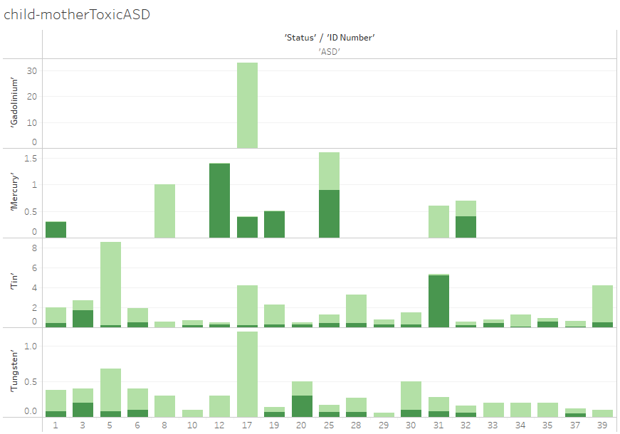
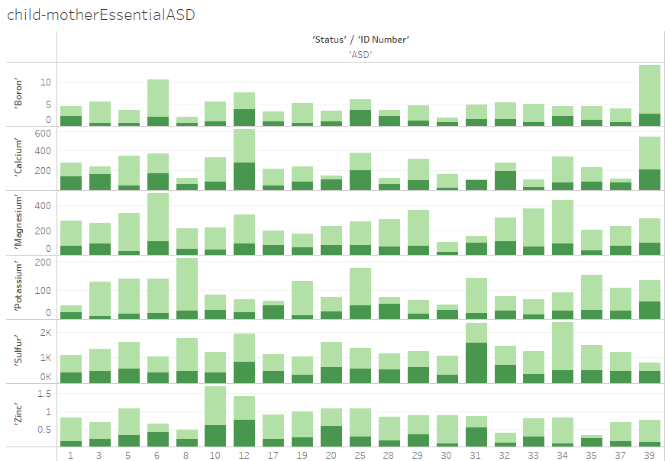

HOW DOES THE URINE TEST DIFFER (TOXIC VS. ESSENTIAL) FOR CHILDREN WITH AUTISM (ASD) TO THEIR MOTHERS WITH AUTISM (ASD)?
OBJECTIVE FIVE
childMotherToxicASD
‘Status’/’ID Number’ ‘ASD’
childMotherEssentialASD
‘Status’/’ID Number’ ‘ASD’
GADOLINIUM
‘Status’/’ID Number’ ‘ASD’
BORON
CALCIUM
MERCURY
POTASSIUM
MAGNESIUM
TIN
TUNGSTEN
SULFUR
ZINC
childMotherToxic ASD
childMotherEssential ASD
CONCLUSION: Tin and Tungsten mostly influence ASD children. Mercury is present in 8 out of 47 pairs (17%) with uneven distribution between children and mothers. Gadolinium is dominantly present in one child (2%) of the ASD participants.
CONCLUSION: Most children have higher amounts of all essential elements compared to their mothers.
Notes:
Rachelle:
Objectives Five & Six delve into analyzing how urine tests differ for children compared to their mothers.
These comparative graphs identified the differences in the levels of significant toxic and essential elements between ASD children and their ASD mothers.
The children are graphed using light green; mothers in dark green.
The graph to the left presents that Tin and Tungsten have a significant influence on ASD in children.
We also found that Mercury was present in 8 out of 47 pairs (17%) but with uneven distribution between children and mothers.
In addition, our study found that Gadolinium was dominantly present in only one child (2%) among the ASD participants.
These findings suggest that certain toxic elements may have a higher impact on ASD in children compared to mothers, and that the distribution of specific elements varies among individuals with ASD.
The graph to the right suggests that most ASD children have higher levels of all the isolated essential elements than their respective ASD mothers.

Slide 12
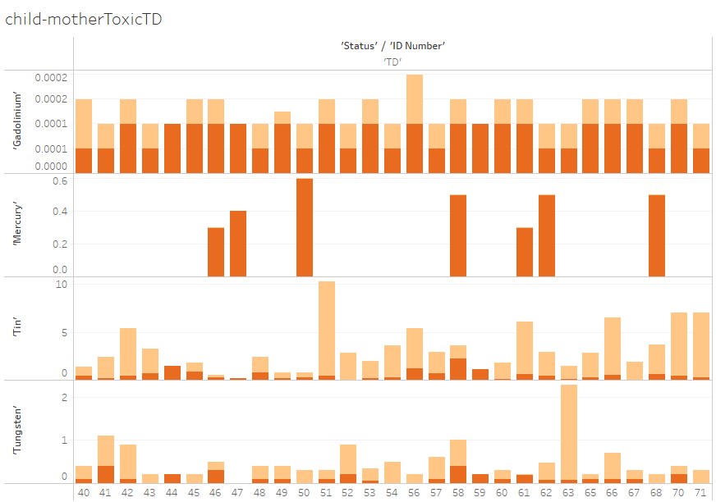
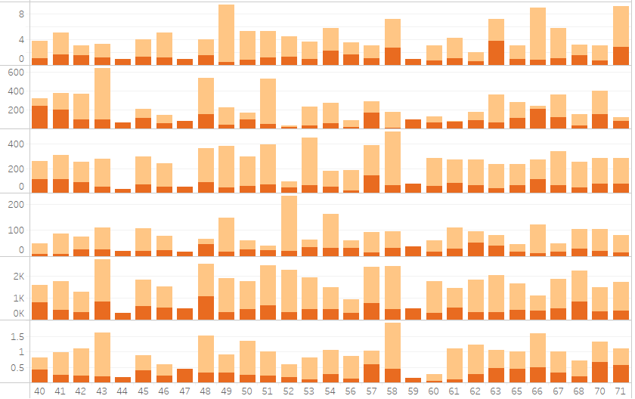

HOW DOES THE URINE TEST DIFFER (TOXIC VS. ESSENTIAL) FOR TYPICALLY DEVELOPING (TD) CHILDREN TO THEIR MOTHERS?
OBJECTIVE SIX
GADOLINIUM
‘Status’/’ID Number’ ‘TD’
‘Status’/’ID Number’ ‘TD’
childMotherToxicTD
childMotherEssentialTD
BORON
MERCURY
CALCIUM
POTASSIUM
MAGNESIUM
TIN
TUNGSTEN
SULFUR
ZINC
childMotherToxic TD
childMotherEssential TD
CONCLUSION: Gadolinium influences both TD children and mothers. Tin and Tungsten mostly influence children. Mercury is not present in TD children and is only present in 7 out of 58 mothers (12%).
CONCLUSION: Most TD children have higher amounts of all essential elements compared to their mothers. Three TD children are missing all essential elements which might explain the variance in the model accuracy.
Notes:
Samantha:
These graphs showcase the differences in the significant toxic & essential elements between the TD children and their specific mothers.
The children are represented with orange and the mothers are represented with red in both graphs.
Glancing at the first graph you can see that very few mothers of TD children have mercury in their UA results & their children do not.
Tin and tungsten is more present in TD children.
And Gadolinium is closely related between TD children and their mothers.
In the second graph you can see a significant amount of TD children have higher influence of essential elements than their mothers.
And this could potentially explain the variance in our model accuracies.

Slide 13
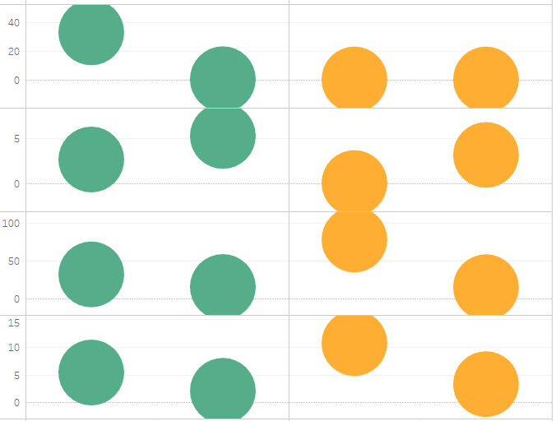
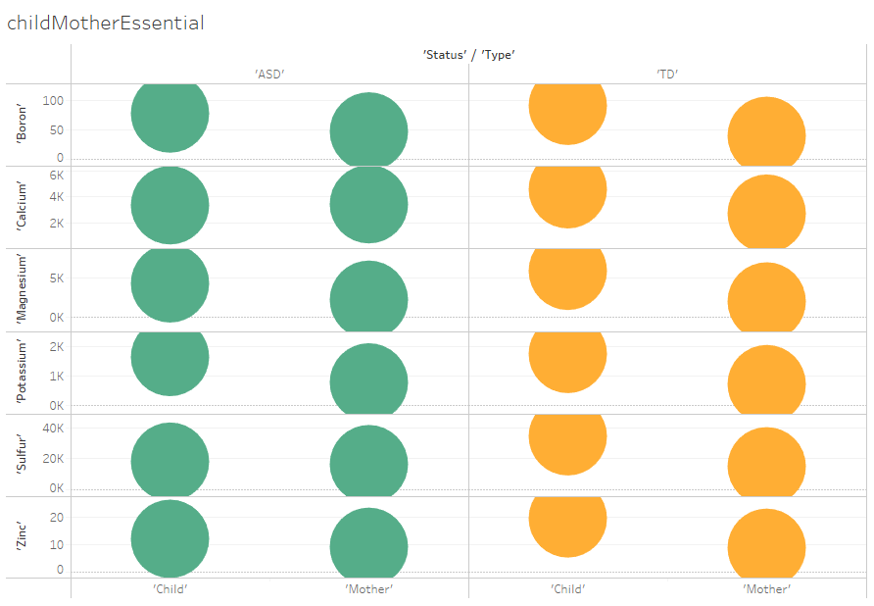
IS THERE A GENERATIONAL INFLUENCE WITHIN INDIVIDUAL ELEMENTS THAT CAN SIGNAL ASD FROM MOTHERS TO THEIR CHILDREN?
OBJECTIVE SEVEN
childMotherToxic
childMotherEssential
ASD
‘Status’ / ‘Type’
TD
ASD
‘Status’ / ‘Type’
TD
GADOLINIUM
BORON
CALCIUM
MERCURY
MAGNESIUM
POTASSIUM
TIN
SULFUR
TUNGSTEN
mother
mother
ZINC
mother
mother
child
child
child
child
CONCLUSION: ASD and TD children have higher levels of Toxic and Essential Elements except for Mercury, which is higher in both ASD and TD mothers
Notes:
Rachelle:
After identifying significant models and elements for both children and mothers, ASD and TD, in both Toxic and Essential elemental groups,
our final analysis objective includes comparing generational influences between both ASD and TD child-mother pairs, linked together in the data by an ID number.
Our analysis revealed that both ASD and TD children have higher levels of toxic and essential elements compared to their respective mothers.
However, mercury levels were higher in both ASD and TD mothers.
This suggests that mercury exposure may have been reduced in the next generation of children but still impacts mothers today.
It's important to note that further research is needed to determine the exact sources of mercury exposure in mothers and its potential impact on child development
Tin and Tungsten again emerged as higher in TD children than any other subgroup. Further research is warranted to understand Tin and Tungsten’s role in the body since the data originally categorized these elements as Toxic yet are lower in both ASD children and mothers.

Slide 14
SUMMARIES & CONCLUSIONS
The significant elements identified for the toxic elements were Tungsten and Lead and for the essential elements they were Sulfur, Magnesium, and Molybdenum.
Additional elements emerged as significant predictors of ASD for both toxic and essential element models in each subgroup, but with lower model accuracy.
Children: Significant predictors in the toxic element model were Gadolinium, Tin, and Mercury, and in the essential element model were Potassium, Boron, Calcium, and Zinc.
Mothers: Significant predictors in the toxic element model were Cadmium, Gadolinium, Lead, and Thallium, and in the essential element model were Iron, Molybdenum, and Phosphorus.
Tungsten, Sulfur, and Magnesium were significant predictor elements for children, while Tungsten, Lead, and Molybdenum were significant for mothers. Notably, Tungsten was the only element that was significant in both groups.
The accuracy of the data in predicting ASD was comparatively higher in children (85-87%) than in mothers (74-78%).
The most challenging aspect of the project was balancing the need to subset the data by dependent and independent variables without compromising the sample size required for predictive and stepwise regression analysis.
With more time we would compare urinalysis results to recommended levels of toxic and essential elements for
children and mothers to identify patterns of nutrient deficiency/sufficiency, as well as investigate the role of
individual toxic/essential elements in childhood development to provide actionable feedback for mothers of
children with ASD.
Notes:
Samantha:
This project has been quite the adventure for our team.
We’ve had so many questions pop up in our processes
And we know the data has more that we could shed light on.
We’ve held a special interest in this topic of discussion because we live in a world with so much to be discovered to help people in need.
The people on the spectrum of ASD exist in a world that isn’t catered to being neurodiverse
but largely caters to the abilities of the neurologically typical people.
With insights like these, we could help to bridge the gap in everyone's abilities.
Further evaluations of the elements found in ASD and TD people, particularly in children-
Provides the ability to find patterns that could unlock mysteries of our minds with impact on our development as humans, and how we can better shape our futures through influence.
Rachelle: In Summary we identified significant elements for both toxic and essential elements. Tungsten and Lead were identified as significant for toxic elements, while Sulfur, Magnesium, and Molybdenum were significant for essential elements. We also found additional significant predictor elements for each subgroup, such as Gadolinium, Tin, and Mercury for children in the toxic element model, and Cadmium, Gadolinium, Lead, and Thallium for mothers in the toxic element model. Tungsten was the only significant element identified in both groups.
While the accuracy of predicting ASD was higher in children (85-87%) than in mothers (74-78%), additional elements emerged as significant predictors of ASD for both subgroups, although with lower model accuracy.
One of the biggest challenges we faced was finding a balance between subsetting the data by dependent and independent variables while maintaining an adequate sample size for predictive and stepwise regression analysis.
Given more time, we would investigate the role of individual toxic and essential elements in childhood development and compare urinalysis results to recommended levels of these elements for children and mothers. This would help us identify patterns of nutrient deficiency or sufficiency and provide actionable feedback for mothers of children with ASD.

Slide 15
CREDITS
We would like to use this space to provide a special thanks to the following people who helped us along the way in completing this project:
Instructor, Joseph Raetano -
Data Science Instructor, Margaret Martinez -
Data Science Mentors, Kendra Rhoades & Julie Boucher
The source of the brain image is:
Elisa Riva, Brain Mind, Pixaby, Feb. 13, 2017.
The source of the downloadable dataset is:
Qureshi, Fatir (2020), “Data for: Urinary Essential Elements of Young Children with Autism Spectrum Disorder and their Mothers”, Mendeley Data, V1, doi: 10.17632/79fk29dvk6.1
The source of the article containing the data is :
Fatir Qureshi, James Adams, Devon Coleman, David Quig, Juergen Hahn, Urinary essential elements of young children with autism spectrum disorder and their mothers, Research in Autism Spectrum Disorders, Volume 72, 2020, 101518, ISSN 1750-9467, https://doi.org/10.1016/j.rasd.2020.101518.

Slide 16
THANK YOU FOR JOINING US TODAY
FLOOR OPEN TO QUESTIONS
DISCUSSION REVIEW

